Slide 1
Nonemployer establishments in Colorado 2016
Diana Ir
Data Wrangling

Slide 2
Data background
WHAT/WHY?
A nonemployer business is one that has no paid employees, has annual business receipts of $1,000 or more ($1 or more in the construction industries), and is subject to federal income taxes.
Significance: Business is extremely important to a country’s # economy because businesses provide both goods and services and jobs.
The dataset 'NES_2016_00A2_with_ann.csv' was collected by the United States Census Beauru 2016
Can we find out how many nonemployer businesses were established in 2016 from each county?
Which county had the highest business establishments?
DATA WRANGLING
According to the metadata key, there were a lot of missing and inaccurate data to which they defined it as:
D = disclosed
S = did not meet # publication standards
N = not available in the dataset
Change the nonemployment column from character to integer/float for computational purposes and visuals
In addition to that, a category in one of the variables was not appropriate for data analysis
“Total for all sectors”
Computing this in will skew the data metrics, so I would have to remove this category

Slide 3
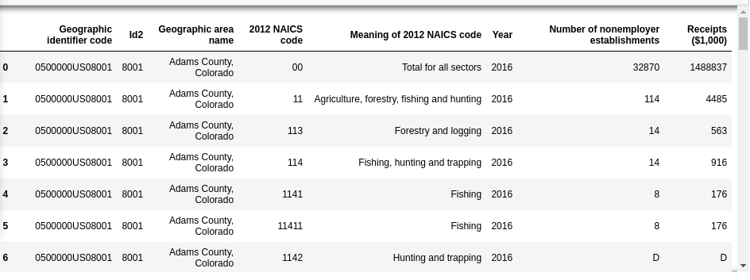
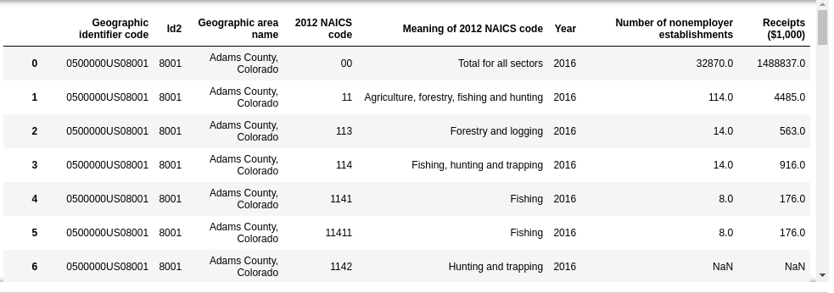
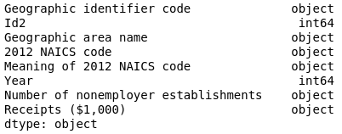
3. Drop the NaN for computational purposes
Removing text in the numerical columns - D, S, N
2. Change object to int64 or float for computational purposes
4. Remove the ‘total for all sectors’
Because including this will skew statistical data

Slide 4
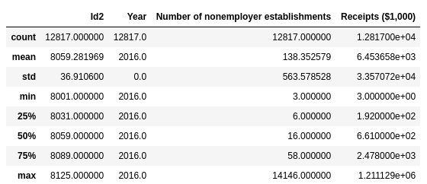
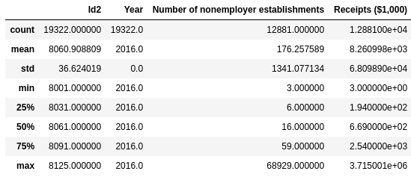
After removing D, S, N, columns of the nonemployer establishments were still “object”
After I removed the ‘total sectors for all.’ Data metrics changed, it looks like the mean and std is much lower. The max also changed.
After I converted the “object” to “float”

Slide 5
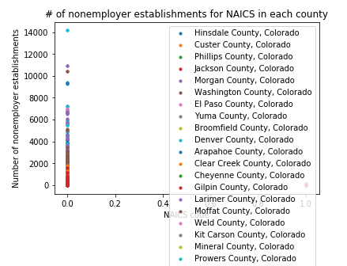
To answer my question: Denver County, CO had the highest # of nonemployer establishments in 2016

